Slide 1
Check-in for the Session
During this session we will be using a poll to track attendance
To access the poll from your laptop OR mobile device, either:
Scan the QR code on your phone/device
Or type the below URL into your browser:
https://forms.microsoft.com/e/Gyeb4RQJYd

Slide 2
UPDATE
A Comprehensive Approach to F-ROC Administration
XXXX County
June XX, 2023
Notes:
Facilitator – update before you present location and date.

Slide 3
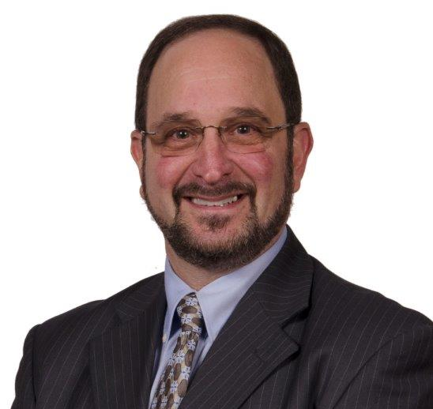
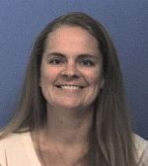
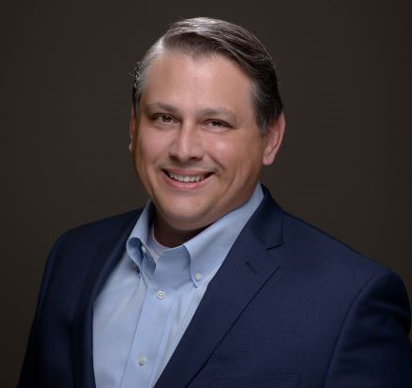
With You Today
UPDATE
Barry Flink
Melissa Foggy
Matt Ramirez
Notes:
Facilitator – update before you present with your photo.

Slide 4
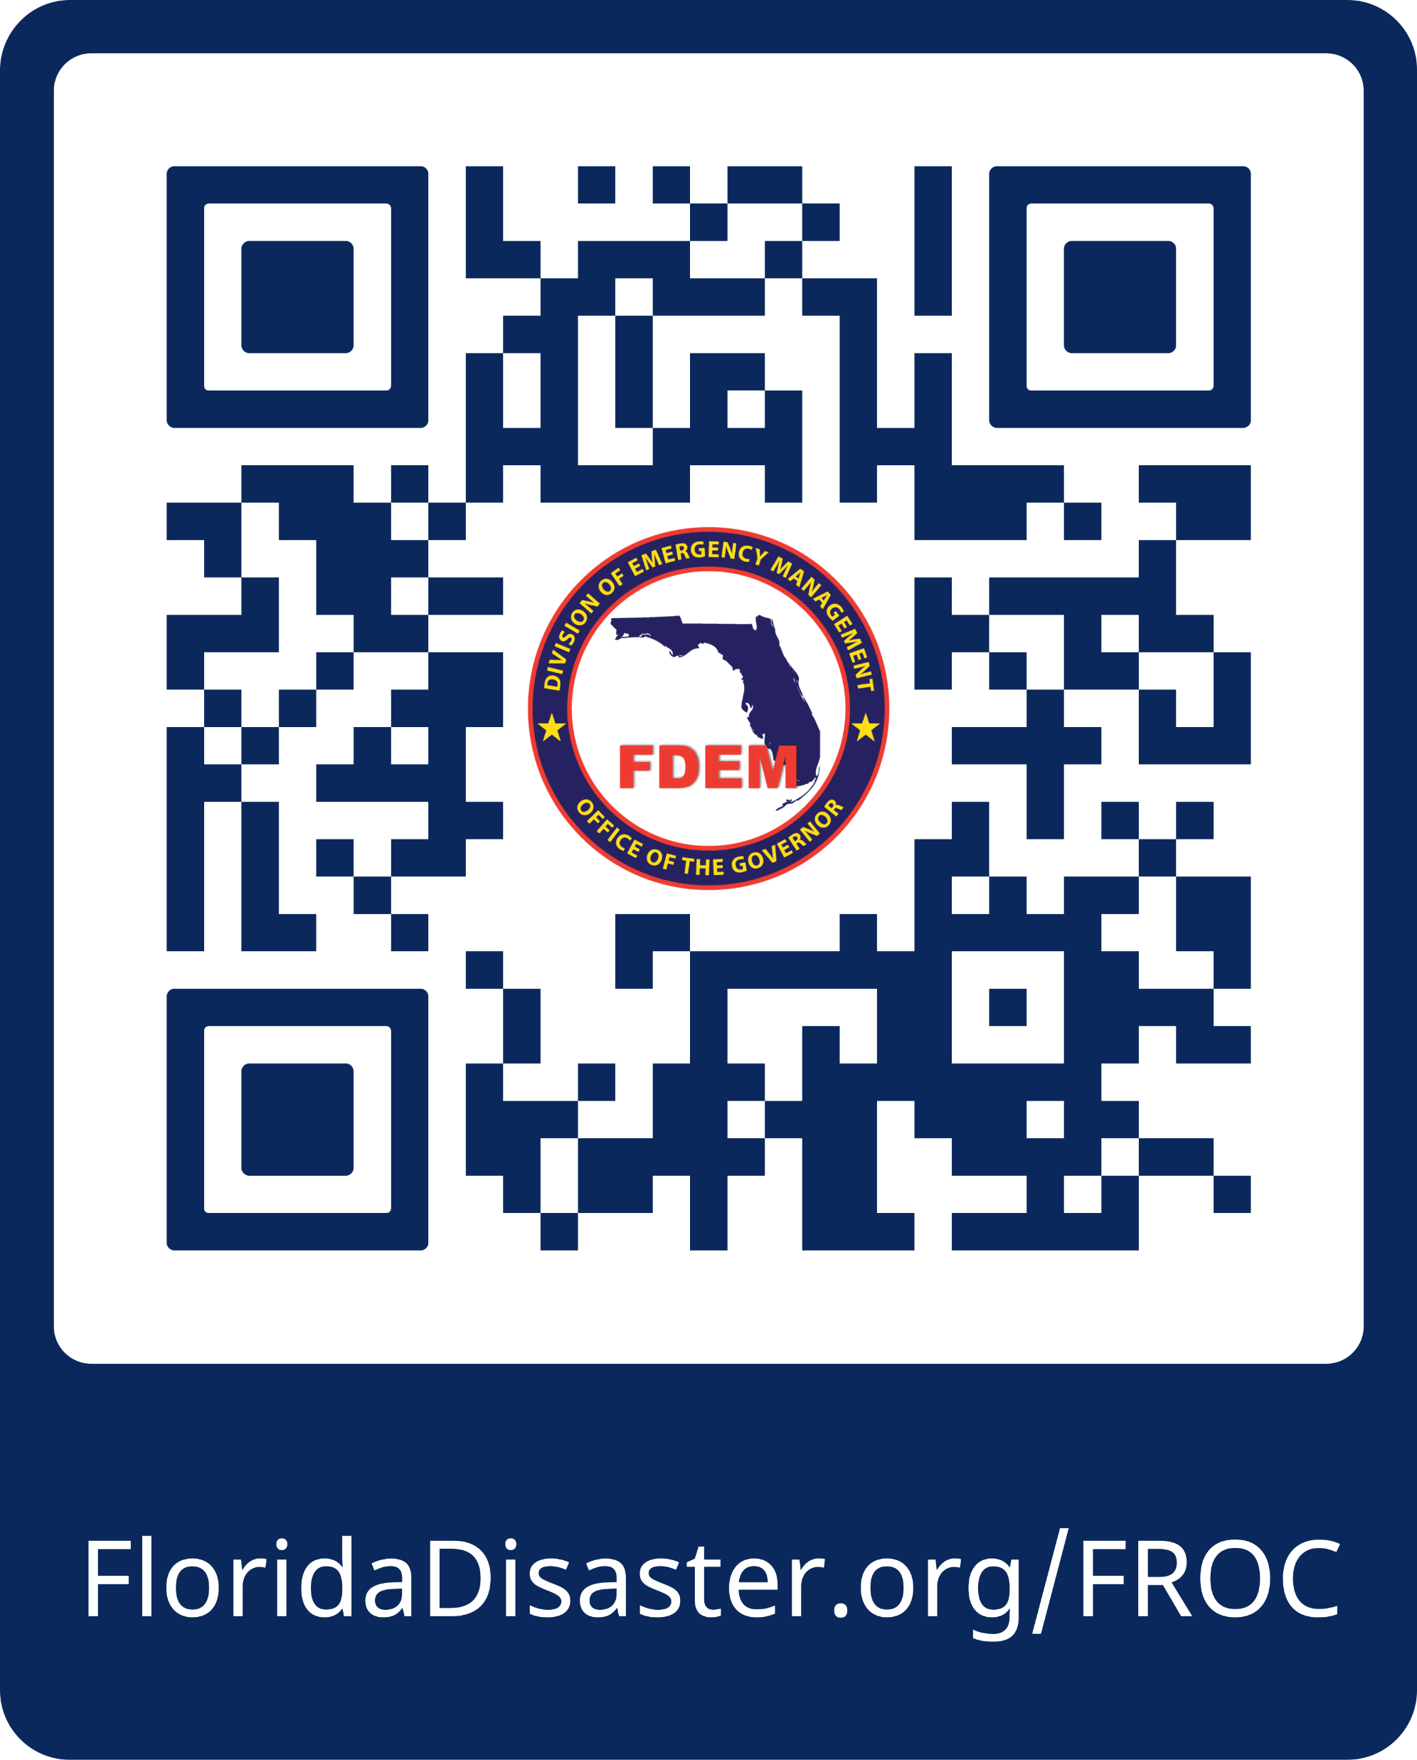
For Your Information

Slide 5
Course Objectives
01
05
Examine the importance and intricacies of completing a Disaster Readiness Assessment.
Gain hands-on experience reviewing, revising, and fine-tuning a Customized Abatement Plan to ensure it aligns with your organizational goals and community needs.
02
06
Explore best practices for engaging stakeholders and obtaining their input in completing your Disaster Readiness Assessment.
Examine the importance of completing a Post-Disaster Questionnaire as part of the recovery process.
03
07
Explore the significance of your Customized Abatement Plan in disaster preparedness.
Apply practical techniques to communicate and share findings from Post-Disaster Questionnaires with relevant stakeholders.
04
08
Learn how to interpret and analyze data from the Customized Abatement Plan.
Gain a comprehensive understanding of F-ROC forms and documentation and their significance in the Public Assistance process.

Slide 6
Course Agenda
01 | Overview of F-ROC
02 | Exploring F-ROC Forms and Documentation
03 | F-ROC Applicant Process
04 | Integration and Application
05 | Wrap-Up

Slide 7
Module 1 Overview of F-ROC

Slide 8
F-ROC Comprehensive

Slide 9
Why does Public Assistance Need a Change?
“We’re still waiting on closeouts for Hurricane Matthew and Hurricane Irma. Anything to make this process faster would really help.”
The process of Public Assistance is complex and time-consuming. Applicants are required to navigate a maze of bureaucratic procedures, paperwork, and reporting requirements. This administrative burden strains already limited resources and slows down the recovery process. Some of the many challenges are:
“I wish we had this process before. It would’ve been invaluable to us.”
 | Inaccurate, incomplete, or inconsistent documentation has caused an increase in de-obligations.
 | There is a lack of standards when it comes to documentation – paperwork is often submitted in a variety of formats (like PDFs, Excel spreadsheets, emails, and scanned files).
 | Public Assistance efforts are too reactive. Most of the work being done for an event takes place after it has already occurred, exacerbating the suffering of affected communities.
 | Post-event funding to help address the immediate needs of impacted communities is often delayed or even clawed back, hindering recovery and rebuilding efforts.
 | A lack of risk-based approaches in Public Assistance results in challenges with OIG findings, audits, and compliance.
“Anything that will make this more streamlined and efficient seems like a bonus to me!”
“When I think of Public Assistance, I think of tedious paperwork and looming deadlines.”

Slide 10
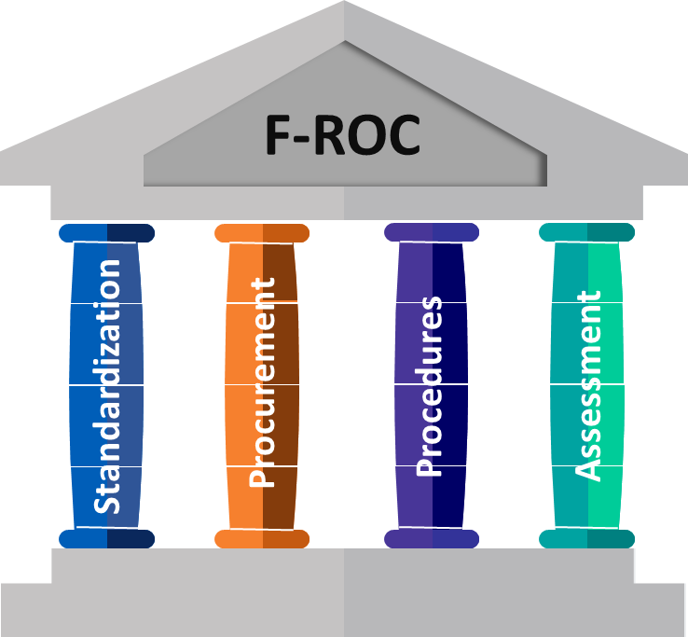
What will Help Change Public Assistance?
The State-sponsored F-ROC initiative addresses current-state challenges by encouraging a proactive and streamlined approach to recovery, reducing risk, and implementing measures that enhance Applicants’ ability to successfully navigate the Public Assistance process.
PILLAR 1: STANDARDIZATION
PILLAR 3: PROCEDURES
F-ROC standardizes and simplifies forms, making it easier to submit accurate documentation for Public Assistance and receive funding timely.
F-ROC helps you prepare for events by ensuring you have policies and procedures that are accurate, up-to-date, and follow FEMA guidelines.
PILLAR 2: PROCUREMENT
PILLAR 4: ASSESSMENT
F-ROC helps you to ensure you have contractors and vendors in place and your procurement plans meet federal regulations.
The Disaster Readiness Assessment provides you with the insights needed to be successful. You can opt-in for free and receive up to 80% of funding upfront.

Slide 11
F-ROC Scoring
The Florida Iceberg! Just like the majority of an iceberg isn’t visible, the majority of PA funding can be received upfront through the F-ROC process.
Once validation of supporting documents is complete, you will receive the remainder of the validated, obligated amount
The maximum F-ROC score is 80. This score is made up of three components:
20
Post Disaster Questionnaire (F-ROC Forms and Training)
With F-ROC, you can receive up to 80% Funding Upfront
40
Disaster Readiness Assessment
20
Baseline
*5 bonus points can be earned with EMAP accreditation

Slide 12
Module 2 Exploring F-ROC Forms and Documentation

Slide 13
Standardized Forms
Contract Work Summary Record | Demolition of Private Property Eligibility Checklist | Leaner-Hanger-Stump Ticket – Example | Mutual Aid - State Mission Cost Estimate Form - Editable Travel
Crew Time Report | Donated Resources - Emergency Work Checklist | Load Site Log | On-Hand Materials and Supplies Usage Log
Daily Activity Report- Inmates | Equipment Inventory Log | Mosquito Abatement – Vector Control Checklist | Public Assistance Applicant Procurement Compliance Checklist
Daily Activity Reports- Individual | Expanded Daily Activity Reports – Team - National Guard | Mutual Aid - EMAC R-2 | Right of Entry – Example
Daily Activity Reports- Individual EMS | FEMA EHP Completeness Checklist for CAT A and B Permit Reference List | Mutual Aid - SMAA Local Resource Support Agreement | Sign-In Sheet
Daily Activity Reports- Individual Firefighter | First Push Activity Log | Mutual Aid - State Mission Cost Estimate Form - Editable | Stump Summary
Daily Activity Reports – Individual – Law Enforcement | Haul-Out Log | Mutual Aid - State Mission Cost Estimate Form – Editable EC. | Tower Monitor Summary Form
Daily Activity Reports- Team | Initial Damage Assessment | Mutual Aid - State Mission Cost Est. Form – Editable Equipment Rates | Truck Certification Form & Instructions
Daily Roving Monitor Log | Labor Backfill Form | Mutual Aid - State Mission Cost Est. Form - Editable Materials | Unmanned Equipment Usage Log
Debris Load Ticket Template | Labor Roster | Mutual Aid- Claim Summary Form
Debris Management Site Checklist | Leaner-Hanger Summary | Mutual Aid - State Mission Cost Estimate Form - Editable PC

Slide 14
Group Activity Instructions
Read and analyze the questions.
In your team, brainstorm solutions. Each member of the group should engage in the conversation and share their personal experiences. Remember, there are no right or wrong answers.
Evaluate and select the best solutions. In your team, discuss the merits of different solutions and ultimately agree on the most viable and appropriate option.
Prepare a report back for the class. In your group you may want to designate a person or people who will share your recommendations back to the class.

Slide 15
Group Activity – Standardized Forms
Instructions:
Navigate to the F-ROC homepage https://www.floridadisaster.org/FROC/
Use the F-ROC files and forms to answer the questions on the following slides.

Slide 16
Group Activity – Standardized Forms
Fill in the blank: "The Initial Damage Assessment Form is used to ____________________________________for the purpose of meeting a county threshold for a declaration.”
Navigation: Damage Assessment > Initial Damage Assessment (F-ROC-FOR-005)
How many inches minimum in diameter must an incident-damaged tree be in order for FEMA to consider it hazardous and eligible for removal?
BONUS: Name one (or more) additional eligibility criteria for hazardous tree removal
Navigation: Debris > Leaner-Hanger-Stump Guidance (F-ROC-GUI-005)
On page 1 of the Donated Resources Daily Activity Report, what is the definition of the following?
Receiving Representative –
Providing Representative –
Navigation: Donated Resources > Donated Resources Activity Report - Daily Log (F-ROC-LOG-011) (PDF VERSION)
True or False: One of the top 10 Procurement Under Grant Mistakes is continuing work under a sole-source contract after the urgent need has ended.
Navigation: FEMA Policies and Fact Sheets > FEMA PDAT - Top 10 Procurement Under Grant Mistakes
Fill in the blank of the following definition:
Disaster Readiness Assessment (DRA): The Disaster Readiness Assessment is a questionnaire completed _______________ that evaluates the Applicant’s __________________ in the Public Assistance program
Navigation: F-ROC Request Form > 2023-2024 F-ROC Participation Request Form for Website
True or False: The PDMG is a group of several points-of-contact assigned to provide customer service to Applicants throughout the Assistance process.
Navigation: Informational One Pagers > WhatToDo_Event_Color_Final
Which of the following is NOT one the required fields on the On-Hand Materials & Supply Usage Log:
Navigation: Labor, Equipment, Materials > On-Hand Materials & Supply Usage Log (F-ROC-LOG-004) (PDF VERSION)
Which of the following are considered essential community services?
Navigation: Procurement, Permitting, Insurance > Relocation of Essential Services (F-ROC-GUI-010)
a) Material Type | c) Time
b) Location | d) Receiver
a) Education | c) Prison
b) Election and Polling | d) All of the above
Notes:
15 minutes

Slide 17
Group Activity – Standardized Forms
"The Initial Damage Assessment Form is used to Summarize the damages from an event for the purpose of meeting a county threshold for a declaration.”
6 Inches (BONUS: Measures 4.5 feet above ground; has a split trunk; has a broken canopy; is leaning at an angle greater than 30 degrees)
Receiving Representative: Individual from the receiving entity that has the authority to receive the donated resources and oversees their intake
Providing Representative: Individual from the providing entity that has the authority to provide/donate the donated resources and oversees the provision/donation
TRUE
Disaster Readiness Assessment (DRA): The Disaster Readiness Assessment is a questionnaire completed prior to a disaster that evaluates the Applicant’s risk of deobligations in the Public Assistance program
FALSE
Location
All of the Above

Slide 18
Activity – Reviewing Forms
For this exercise we will review the following:
Daily Activity Report – Team
Leaner – Hanger Summary
FEMA Policies and Fact Sheets
Equipment Inventory Log
Procurement, Permitting, Insurance

Slide 19
Module 3 F-ROC Applicant Process

Slide 20
F-ROC Applicant Process
Complete Opt-in Course
Sign Participation Request Form
Complete Disaster Readiness Assessment
Create Customized Abatement Plan (based on your options)
Complete and Submit Post Disaster Questionnaire
1
2
3
4
5

Slide 21
F-ROC Applicant Process
Complete Opt-in Course
Sign Participation Request Form
Complete Disaster Readiness Assessment
Create Customized Abatement Plan (based on your options)
Complete and Submit Post Disaster Questionnaire
1
2
3
4
5

Slide 22
Opt-in Course
This e-learning is required for Applicants to complete in order to opt-in to F-ROC.
Description: Provides an overview of the F-ROC opt-in process, including requirements and steps. Participants will be provided with guidance on how to successfully opt-in to F-ROC.
Duration: 1 hour
Target Audience: Appropriate, authorized Public Assistance Representatives
Availability: Mid-June 2023
This eLearning is required for Applicants to complete in order to opt-in to F-ROC.
Description: Provides an overview of the F-ROC opt-in process, including requirements and steps. Participants will be provided with guidance on how to successfully opt-in to F-ROC.
Duration: 1 hour
Target Audience: Appropriate, authorized Public Assistance Representatives
Availability: June 16, 2023

Slide 23
F-ROC Applicant Process
Complete Opt-in Course
Sign Participation Request Form
Complete Disaster Readiness Assessment
Create Customized Abatement Plan (based on your options)
Complete and Submit Post Disaster Questionnaire
1
2
3
4
5

Slide 24
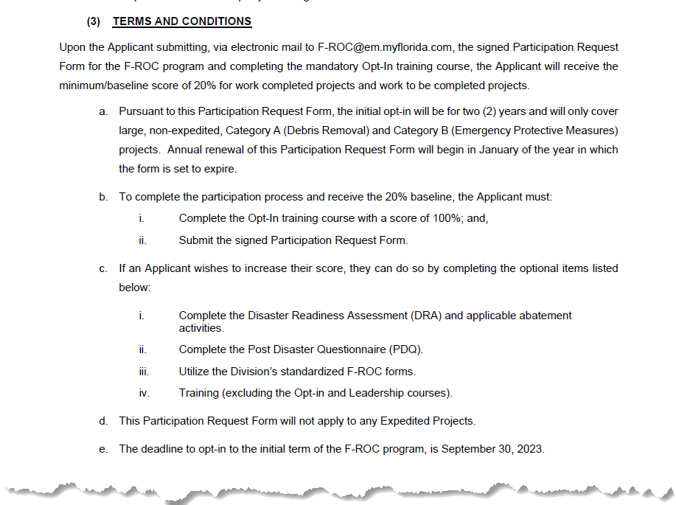
Participation Request Form

Slide 25
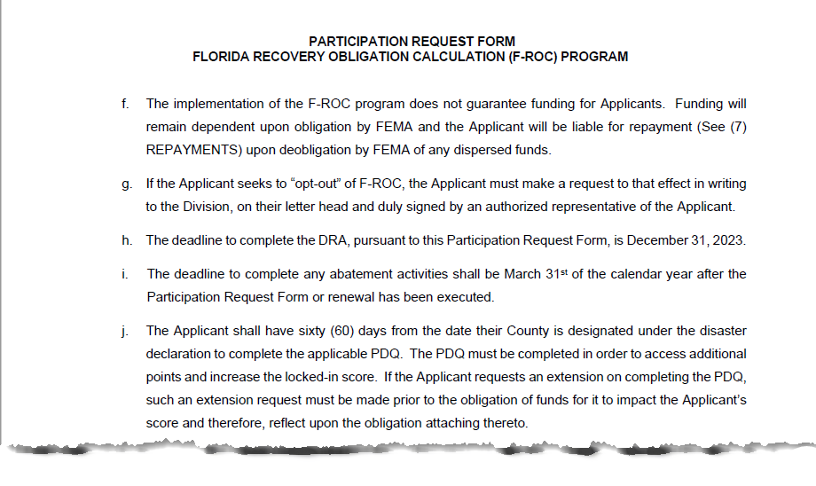
Participation Request Form

Slide 26
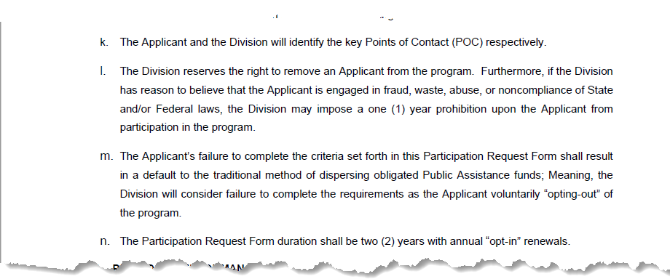
Participation Request Form

Slide 27
F-ROC Applicant Process
Complete Opt-in Course
Sign Participation Request Form
Complete Disaster Readiness Assessment
Create Customized Abatement Plan (based on your options)
Complete and Submit Post Disaster Questionnaire
1
2
3
4
5

Slide 28
Questions for Discussion
F-ROC is built on the idea of “prepare to recover.” Let’s discuss:
What has your organization done in the past to prepare to recover?
What proactive measures can your organization take to prepare for an event that will ensure a swift recovery?
How can your organization effectively assess and mitigate potential risks associated with an event to minimize their impact on the people of Florida?

Slide 29
DRA Process
FDEM validation review
Applicant completes DRA Review with internal stakeholders
Receive DRA score Once you have a score you can create an Abatement Plan
Applicant has access to the DRA KPMG Smart Grant Platform access granted
02
Submit DRA Once you have reviewed and completed questions
04
01
03

Slide 30
Disaster Readiness Assessment (DRA)
Applicant Experience
01
All Disaster Readiness Assessment questions are grouped into two categories, Category A and Category B. The questions in these two categories can then be further broken down into five sub-categories:
Policy and Procedure
02
Documentation
03
Procurement
04
Contract Administration
05

Slide 31
Applicant Experience
Applicant Experience
01
Policy and Procedure
02
Documentation
03
Procurement
04
Contract Administration
05

Slide 32
DRA Questionnaire – Applicant Experience
Instructions:
In your group, review the Applicant Experience questions (1 – 3).
Discuss the following questions in your group:
Which questions will be the easiest to find answers for?
Which questions will be the most difficult to find answers for?
Do you know who you will reach out to in your organization for additional information or feedback?
Are there any questions that are unclear and could use more context?
Designate one of your teammates to report back to the class.
Applicant Experience – Policy and Procedure – Documentation – Procurement – Contract Administration

Slide 33
Policy and Procedure
Applicant Experience
01
Policy and Procedure
02
Documentation
03
Procurement
04
Contract Administration
05

Slide 34
Group Activity – Policy and Procedure
Instructions:
In your group, review the Policy and Procedure questions (4 – 16).
Discuss the following questions in your group:
Which questions will be the easiest to find answers for?
Which questions will be the most difficult to find answers for?
Do you know who you will reach out to in your organization for additional information or feedback?
Are there any questions that are unclear and could use more context?
Designate one of your teammates to report back to the class.
Applicant Experience – Policy and Procedure – Documentation – Procurement – Contract Administration

Slide 35
Documentation
Applicant Experience
01
Policy and Procedure
02
Documentation
03
Procurement
04
Contract Administration
05

Slide 36
Group Activity – Documentation
Instructions:
In your group, review the Documentation questions (17 – 21).
Discuss the following questions in your group:
Which questions will be the easiest to find answers for?
Which questions will be the most difficult to find answers for?
Do you know who you will reach out to in your organization for additional information or feedback?
Are there any questions that are unclear and could use more context?
Designate one of your teammates to report back to the class.
Applicant Experience – Policy and Procedure – Documentation – Procurement – Contract Administration

Slide 37
Procurement
Applicant Experience
01
Policy and Procedure
02
Documentation
03
Procurement
04
Contract Administration
05

Slide 38
Group Activity – Procurement
Instructions:
In your group, review the Procurement questions (22 – 33).
Discuss the following questions in your group:
Which questions will be the easiest to find answers for?
Which questions will be the most difficult to find answers for?
Do you know who you will reach out to in your organization for additional information or feedback?
Are there any questions that are unclear and could use more context?
Designate one of your teammates to report back to the class.
Applicant Experience – Policy and Procedure – Documentation – Procurement – Contract Administration

Slide 39
Contract Administration
Applicant Experience
01
Policy and Procedure
02
Documentation
03
Procurement
04
Contract Administration
05

Slide 40
Group Activity – Contract Administration
Instructions:
In your group, review the Contract Administration questions (34 – 38).
Discuss the following questions in your group:
Which questions will be the easiest to find answers for?
Which questions will be the most difficult to find answers for?
Do you know who you will reach out to in your organization for additional information or feedback?
Are there any questions that are unclear and could use more context?
Designate one of your teammates to report back to the class.
Applicant Experience – Policy and Procedure – Documentation – Procurement – Contract Administration

Slide 41
F-ROC Applicant Process
Complete Opt-in Course
Sign Participation Request Form
Complete Disaster Readiness Assessment
Create Customized Abatement Plan (based on your options)
Complete and Submit Post Disaster Questionnaire
1
2
3
4
5

Slide 42
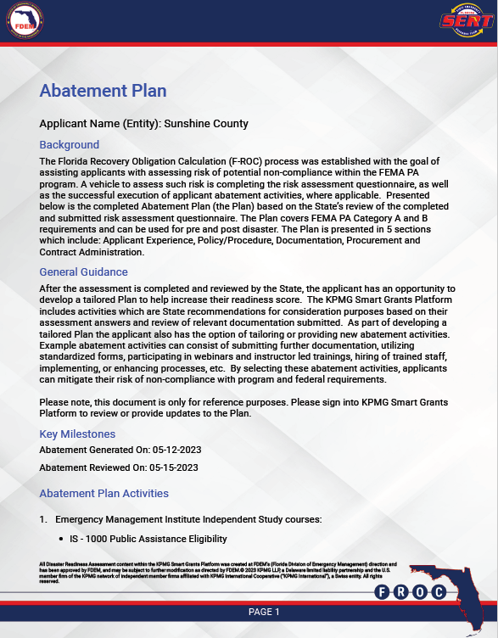
Customized Abatement Plan
Customized Abatement Plan activity:
Review the two Customized Abatement Plans
In your group, respond to the following questions:
What are some current areas of opportunity that your organization may need to address?
Based on the examples, do you see any similarities between these two organizations and your organization?
How will you share and review the Abatement Plan within your organization.

Slide 43
F-ROC Applicant Process
Complete Opt-in Course
Sign Participation Request Form
Complete Disaster Readiness Assessment
Create Customized Abatement Plan (based on your options)
Complete and Submit Post Disaster Questionnaire
1
2
3
4
5

Slide 44
PDQ - Review
Question 1:
Did the Applicant utilize any of FDEM’s standardized form(s)?
Yes, the Applicant utilized applicable FDEM PA standardized form(s).
No, the Applicant did not utilize FDEM PA standardized form(s).
For all forms applicable to the Applicant and work performed, please select the forms utilized.

Slide 45
PDQ - Review
Question 2:
Did an employee(s) from the Applicant attend any FDEM F-ROC training(s)?
Yes, the Applicant attended FDEM F-ROC training(s).
No, the Applicant did not attend any FDEM F-ROC training(s).
If yes, please select all that apply: (courses subject to change)
A Comprehensive Approach to F-ROC Administration
F-ROC: Process overview
F-ROC: Debris Removal using the F-ROC Approach
F-ROC: Procurement using the F-ROC Approach
F-ROC: Project Administration using the F-ROC Approach

Slide 46
Module 4 Integration and Application

Slide 48
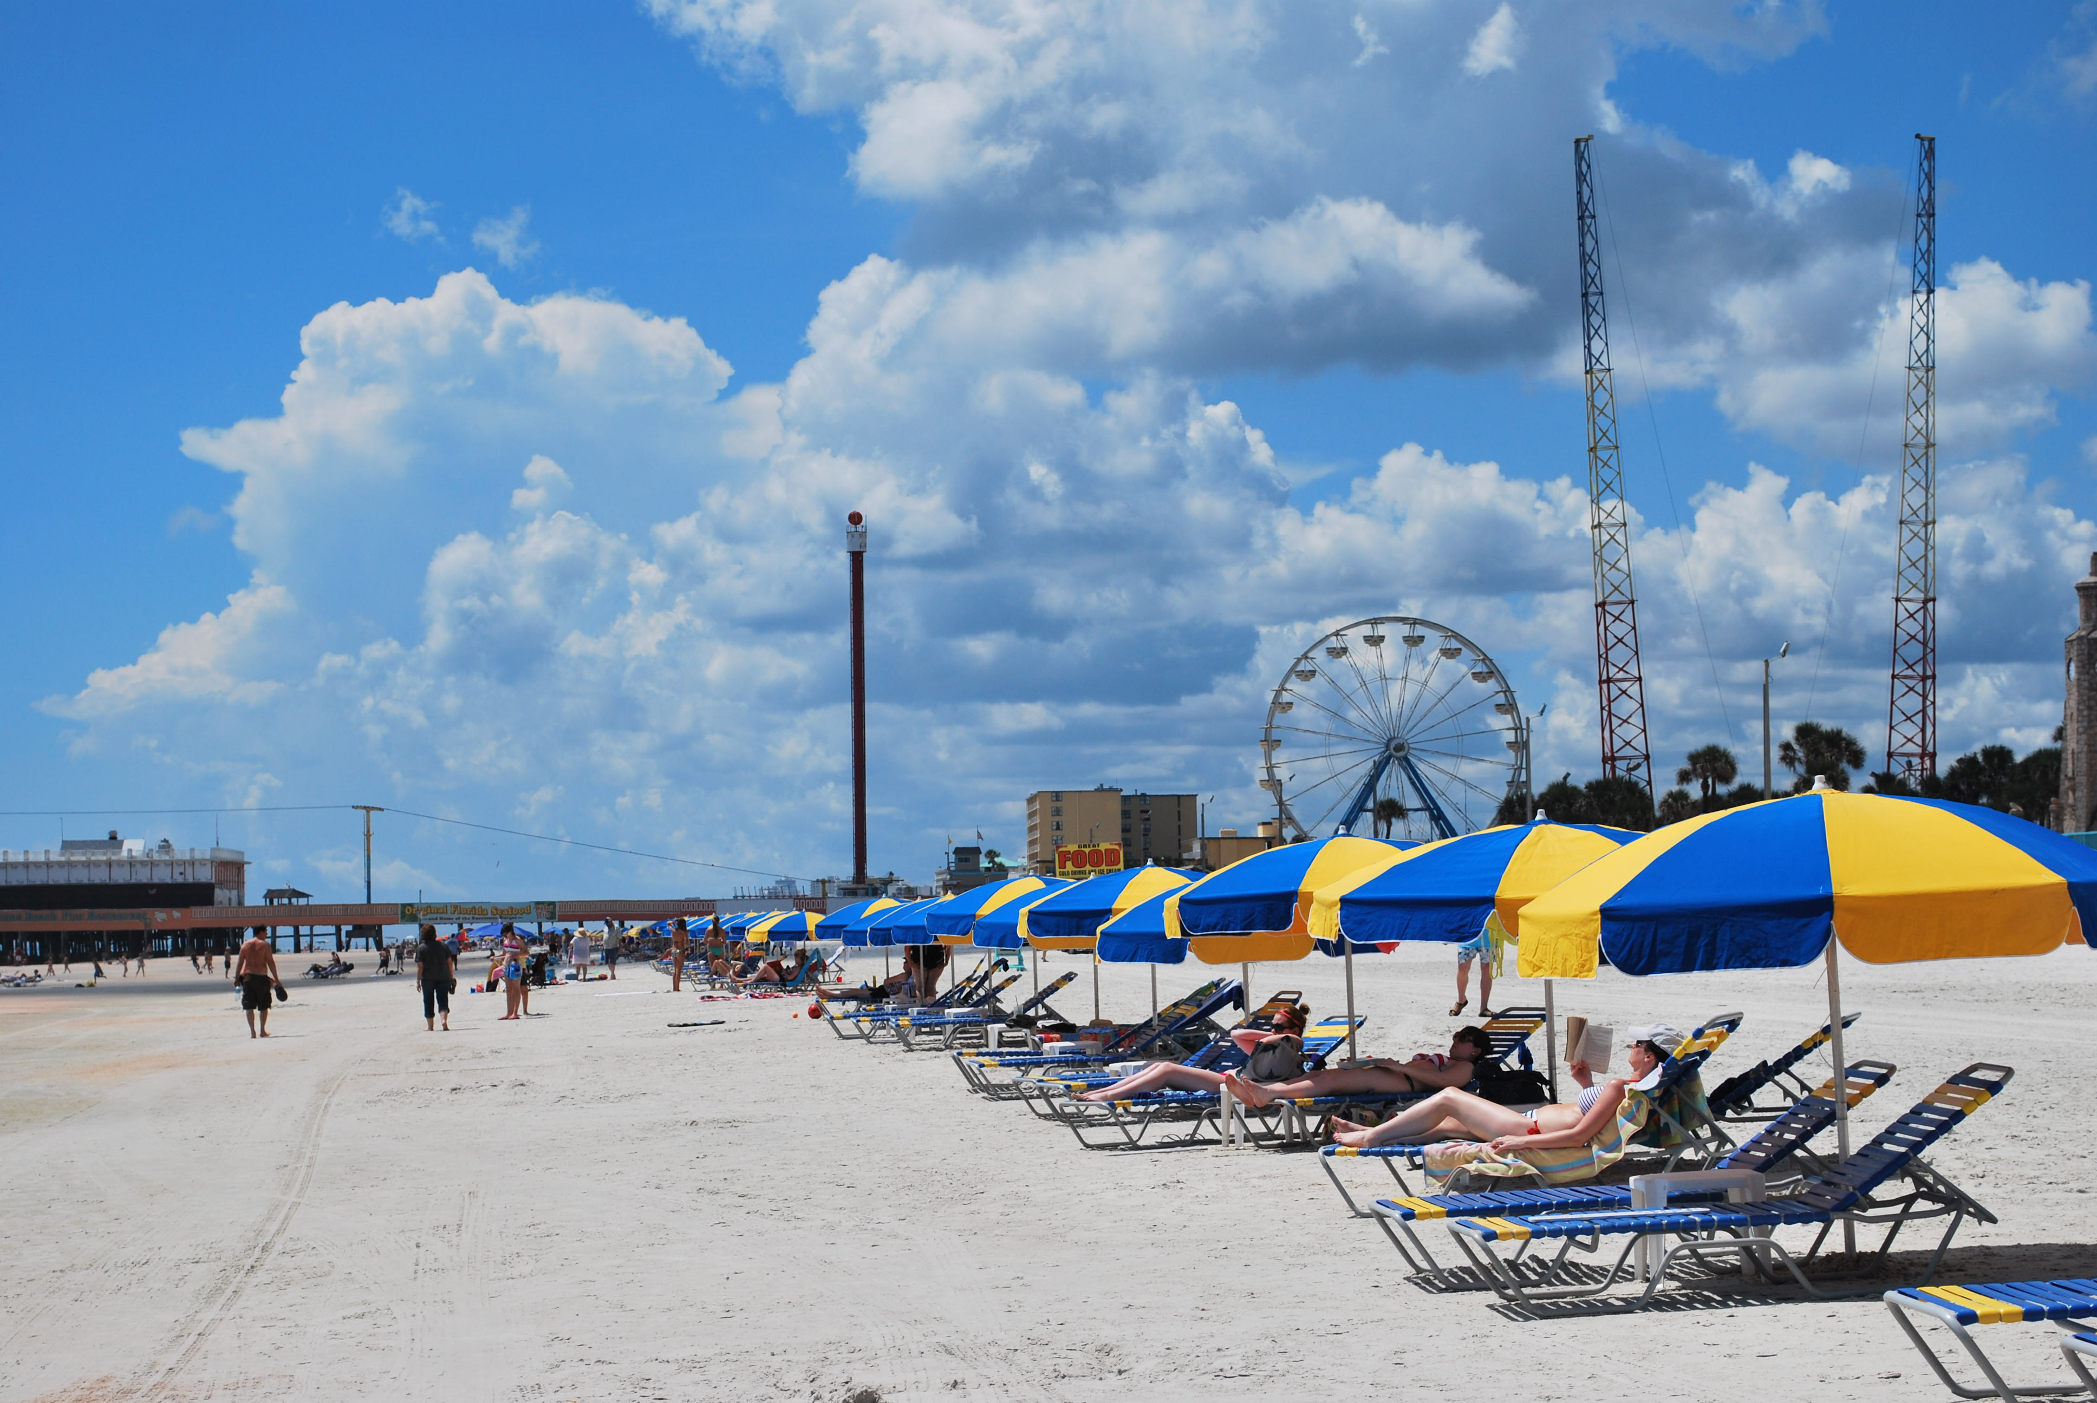
Case Study – Sunshine County
The Road to Recovery for Sunshine County
This case study will focus on efforts of Sunshine County, a picturesque beach community on Florida’s West Coast, as it grapples with the impact of Hurricane Sofia, a Category 3 Hurricane.
The case study will explore steps and activities that Sunshine County can do to prepare before, during, and after the event.
Tools and resources available on the F-ROC website should be used throughout this activity.
Greetings from Sunshine County!
This Photo by Unknown Author is licensed under CC BY-SA

Slide 49
Sunshine County – New EM Director
Rocky has recently been hired as the Emergency Management Director of Sunshine County. He is taking over for Fran, an Emergency Management veteran who held the position for over 20 years.
Rocky is noticing that much of the knowledge and information for his organization, including policies, procedures, and other important information was not written down, and documentation is scarce. He’s only a few weeks away from the Hurricane Season and is scrambling to get everything in alignment.

Slide 50
Sunshine County – Blue Sky Activities
Activity 1:
Background: Rocky has decided to conduct a comprehensive review of all existing documentation for the Emergency Management Division for Sunshine County. Rocky's objective is to assess the current state of documentation, identify any gaps or inconsistencies, and recommend improvements to enhance the division's effectiveness.
In your group:
Document areas of opportunity for Rocky during blue skies. Items to consider: capturing images, written reports, and other important information on county properties.
Identify F-ROC information, forms, and documentation that will help Rocky with these actions.
Identify appropriate next steps for Rocky.
Greetings from Sunshine County!

Slide 51
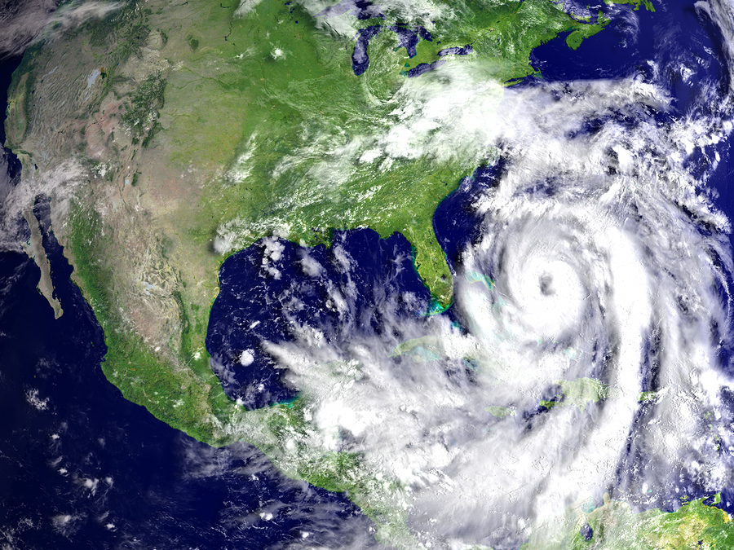
Sunshine County – Storm Activities
Activity 2:
Background: Tropical Storm Sofia has been upgraded to a Hurricane and will eventually become a Presidentially Declared Hurricane, and Rocky and his team are preparing to recover.
In your group:
Review and identify items from Activity 1. Are there any documents, forms, or information that could be updated?
What are any additional steps Rocky could be doing at this moment to prepare to recover?

Slide 52
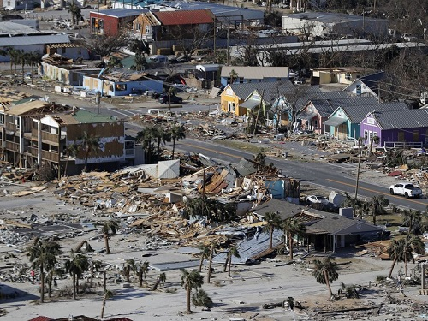
Sunshine County – Post - Storm Activities
Activity 3:
Background: Sunshine County has just experienced Hurricane Sofia, causing widespread destruction and severely impacting services in the area. Several areas of the city are without power, flooding is rampant, and many homes and businesses have experienced significant damage. In response to this crisis, the Sunshine County Emergency Management Team, led by Rocky, is on the job.
In your group:
List action items and next steps for Rocky and his team.
Which available resources on the F-ROC website could be used during this time and how would you use them?
Notes:
Mention something about RPA

Slide 53
Sunshine County – Debrief
In your groups, discuss:
How could the processes, documentation, and resources provided by F-ROC improve the recovery process?
We use the term, “prepare to recover” to describe F-ROC. How is your organization preparing to recover?
How will F-ROC help your organization in the event of an event?

Slide 54
Module 5 Wrap Up

Slide 55
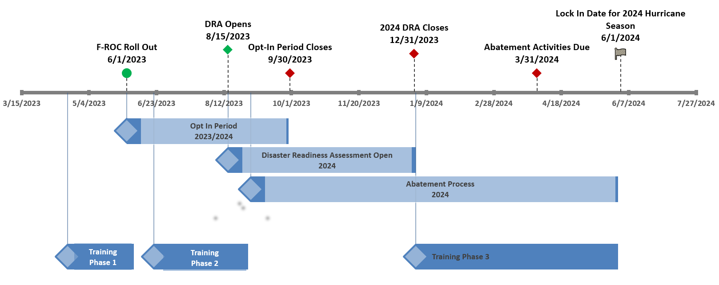
F-ROC Statewide Roll Out

Slide 56
Wrap – up
Questions for discussion:
What were the most valuable concepts or skills you learned during this course?
How has this course impacted your understanding or perspective in the subject matter?
Do you feel we achieved the objectives of this course?

Slide 57
What are You Waiting For?
Opt-in to F-ROC today!
It’s as easy as…
1
2
3
Complete the ~1-hour opt-in e-learning course and exam, and save the auto-generated certificate proving training and exam completion
Complete and sign the “Participation Request Form”
Email the training certificate and signed “Participation Request Form” to the F-ROC team
You benefit from…
Improved project formulation and streamlined processes.
Increased support and knowledge-sharing among peers.
Receive 20% of funding upfront for applicable projects during both the 2023 and 2024 hurricane seasons just by opting in!
Reduction in errors, inconsistencies, and time spent on paperwork using standardized forms.
A more proactive approach to recovery.

Slide 58
How Can I Stay Informed?
Have feedback or ideas?
Want to receive updates?
Please send an email to F-ROC@em.myflorida.com

Slide 59
Course Evaluation
To access the poll, either:
Scan the QR code on your phone/device:
Or type the below URL into your browser:
https://forms.microsoft.com/e/b6xsusnbq5

Slide 60
QUESTIONS?

